Slide 1

A structured framework for analyzing industry, geography, workforce, financial, and temporal dimensions across a multi-attribute company dataset.
Sukanya Naik

Slide 2
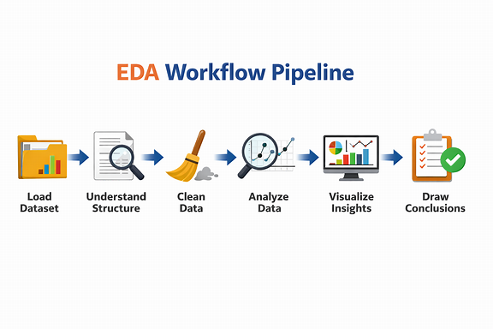
EDA · Industry Dataset
Introduction
Exploratory Data Analysis (EDA) is a statistical process used to understand datasets using Summary statistics, Visualizations and Relationship analysis.
It is typically performed before predictive modeling or machine learning to uncover patterns, anomalies, and insights.
Dataset: Large‑scale industry performance dataset
Size: ~15,000 records, 12 variables
Scope: Comprehensive EDA across multiple dimensions that includes data load, understand structure, clean, analyze & visualize.
EDA on Industry Data · 02

Slide 3
EDA · Industry Dataset
Dataset Overview
Ten columns spanning categorical, numerical, and temporal dimensions of industry entities.
Column | Type | Description
industry | Categorical | Sector classification
country | Categorical | Country of operation
region | Categorical | Macro region grouping
employee_count | Numerical | Workforce size
annual_revenue_million | Numerical | Top-line revenue (M)
profit_margin_percent | Numerical | Profitability ratio
customer_count | Numerical | Active customer base
market_rating | Numerical | Composite market score
founded_year | Numerical | Year of founding
created_date | Date | Record creation date
EDA on Industry Data · 03

Slide 4
EDA · Industry Dataset
EDA Objectives
Understand Structure
Assess Quality
Discover Patterns
Profile data types, ranges, and cardinality across all ten columns.
Identify missing values, duplicates, type mismatches, and date integrity.
Reveal distributions, central tendencies, and skew in numerical fields.
Quantify Relationships
Segment the Market
Surface Anomalies
Measure correlations between revenue, margin, employees, and rating.
Compare industries, countries, and regions across key metrics.
Flag outliers and unusual cohorts requiring further review.
EDA on Industry Data · 04

Slide 5
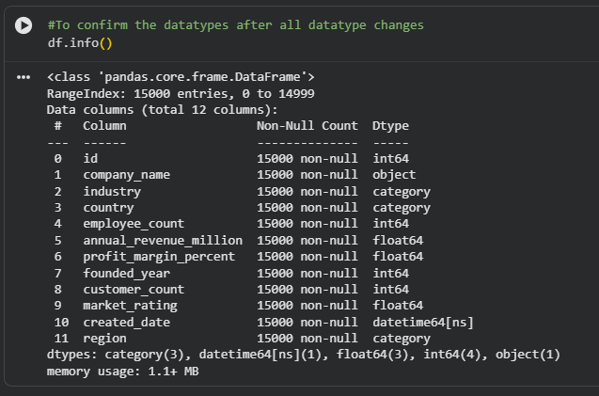
EDA · Industry Dataset
Understanding Data Structure
Preprocessing Steps
Importing all the required libraries like NumPy, Pandas, Matplotlib & Seaborn.
Column Names & Data Types
Identify categorical, numerical, datetime, and text fields by using df.info(). If required change the datatype.
Previewing Data: Use .head() or .tail() to view a few records.
Checking for missing & duplicate values using df.isnull().sum() & df.duplicated().sum()
Checking for null values using df.isnull().sum()
Performing Summary Statistics using describe() in Pandas gives mean, median, min, max, and quartiles for numeric columns that reveals distribution tendencies and potential anomalies.
Performing different types of analysis like univariate, bivariate & multivariate.
Outliers detection using different methods that shows data distribution and outliers if present.
EDA on Industry Data · 05

Slide 6
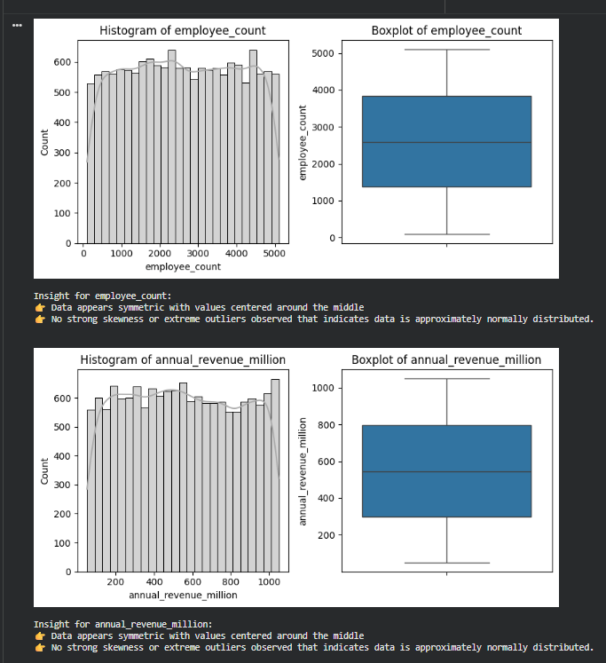

EDA · Industry Dataset
Univariate - Numerical fields
Univariate analysis refers to the analysis of a single variable (one feature) to understand its characteristics and distribution.
Numerical represents measurable values (numbers) like age, salary, height, etc. Supports mathematical operations (add, subtract, average)
By forming a loop of all numerical values plotting histogram & boxplot
Ex: univariate analysis of employee count in histogram and with a median line at center in boxplot showing equal distribution of data across.
EDA on Industry Data · 06

Slide 7
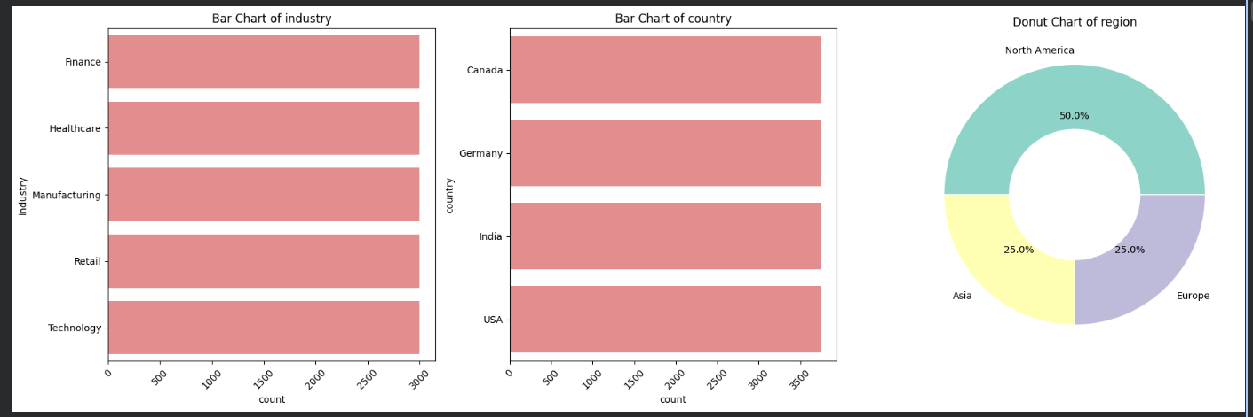
EDA · Industry Dataset
Univariate - Categorical fields
Categorical represents labels or groups (non-numeric values) like gender, region, product type. Cannot perform arithmetic operations
By forming a loop of all categorical values plotting horizontal bar chart & donut visual.
Ex: Donut chart showing percent distribution of data region wise that tells North America has max count compared to other regions.
EDA on Industry Data · 06

Slide 8
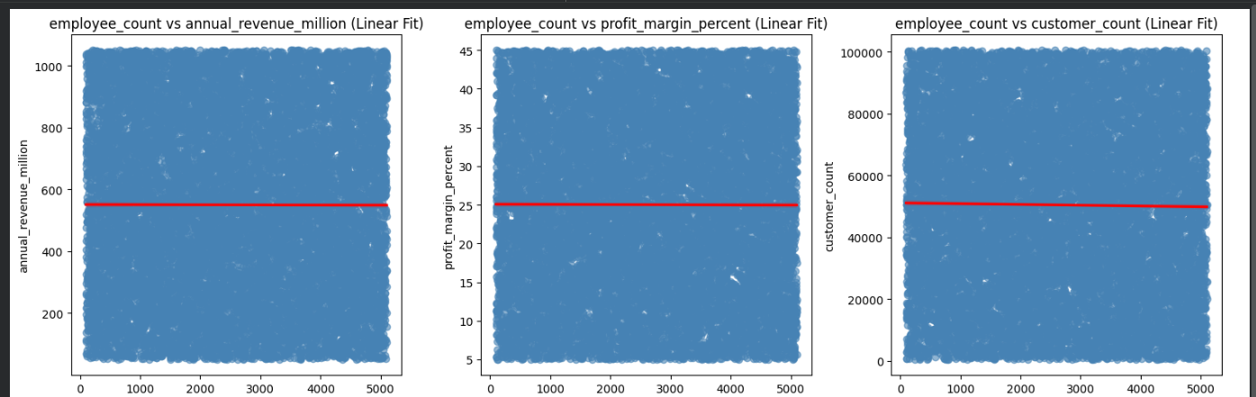
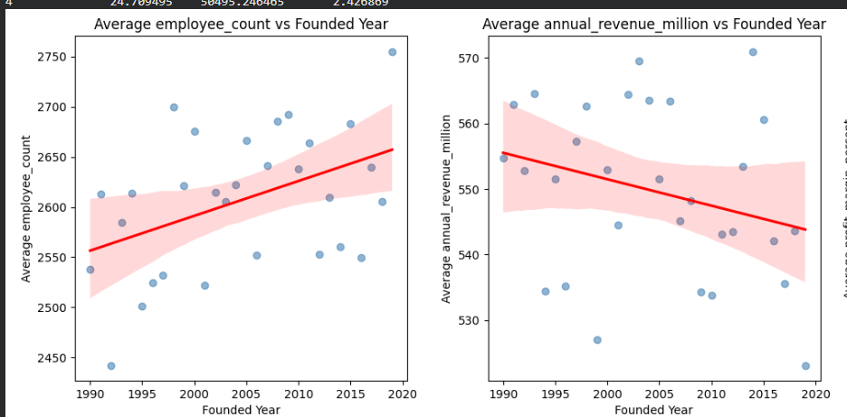
EDA · Industry Dataset
Bivariate – Numerical vs Numerical
Bivariate analysis is the analysis of two variables together to understand the relationship between them.
Numerical vs Numerical Represents analysis between measurable values (numbers) for example - Salary vs Experience Used to find correlation(strength of relationship) or trend.
Eg: in 1st scatterplot visual all the bubbles show a balanced distribution around the median indicating no strong skewness and equally distributed around the median.
In 2nd plot values and line is increasing or decreasing along year showing as the year increases, employee count or annual revenue increases and decreases
EDA on Industry Data · 09

Slide 9
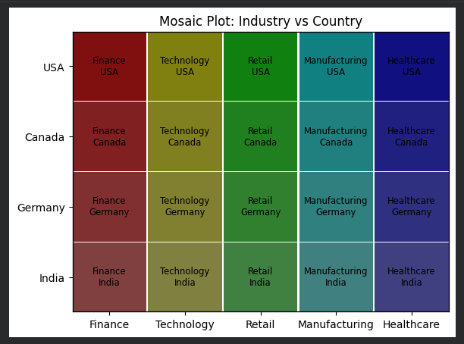
EDA · Industry Dataset
Bivariate - Categorical vs Categorical
Categorical vs Categorical Represents analysis between labels or groups (non-numeric values) for example: Gender vs Product choice
The mosaic plot shows plotting of 2 categorical cols with x-axis as Industry & y-axis as Country that tells that the data is evenly spread with size.
Industry has similar rectangle sizes across countries; it suggests a balanced distribution.
In short: Mosaic plots give a visual snapshot of categorical relationships, helping you spot dominance, imbalance, and associations at a glance.
EDA on Industry Data · 10

Slide 10
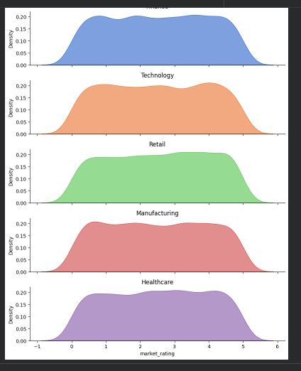
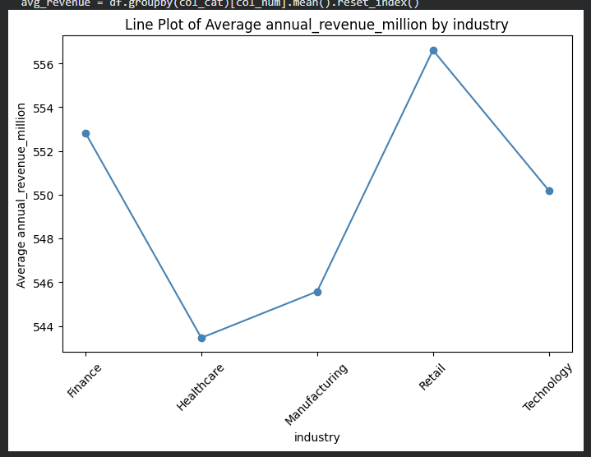
EDA · Industry Dataset
Bivariate - Categorical vs Numerical
Categorical vs Numerical Represents analysis between measurable and non-numeric values for example: Salary vs Gender.
Categorical vs numerical gives a meaningful insight that’s easy to interpret compared to other 2 categories.
1st Line visual showing data of Average Annual Revenue by Industry indicating that Retail industry has highest revenue whereas health care has lowest values compared to others.
2nd Facetgrid showing Industry vs Market rating that shows density of data is evenly spread telling no outliers and independent of each other. Market ratings are consistent across industries. There may be no strong industry effect on this metric.
EDA on Industry Data · 10

Slide 11
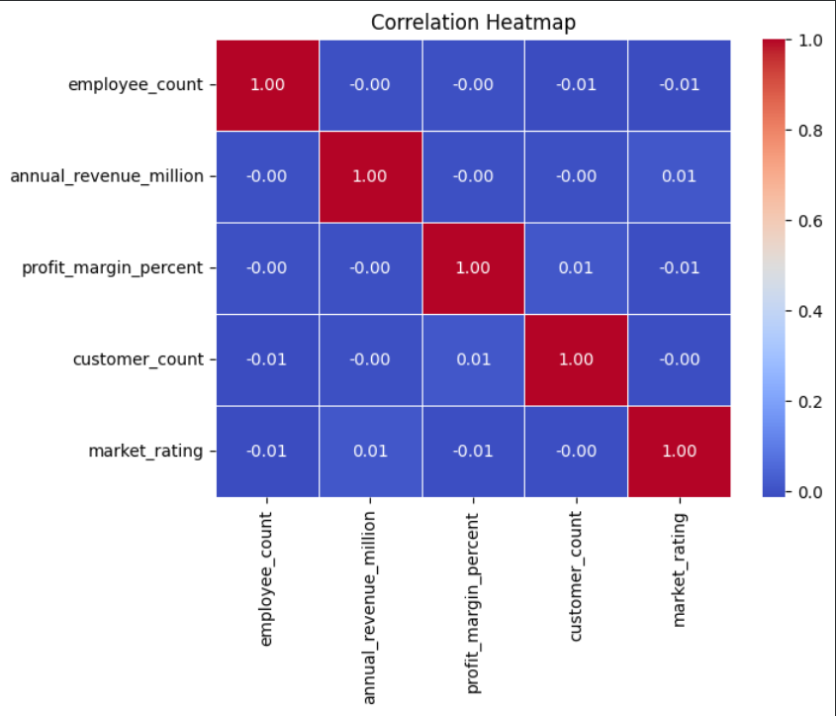
EDA · Industry Dataset
Multivariate · Correlation Matrix
Multivariate analysis is the study of relationships among three or more variables simultaneously, allowing researchers to uncover complex patterns
A Correlation Heatmap is a visual representation that shows the strength and direction of relationships between multiple variables using color-coded values. Revenue ↔ employees count ↔ revenue ↔ customers count ↔ market rating.
Each cell represents the correlation coefficient between two variables. Values range from -1 to +1:
+1 → strong positive relationship
-1 → strong negative relationship
0 → no relationship
Colors help quickly identify patterns: Warmer colors (e.g., red) indicate strong correlation, cooler colors (e.g., blue) indicate weak or no correlation
0.55
0.52
0.55
0.52
1.00
EDA on Industry Data · 11

Slide 12
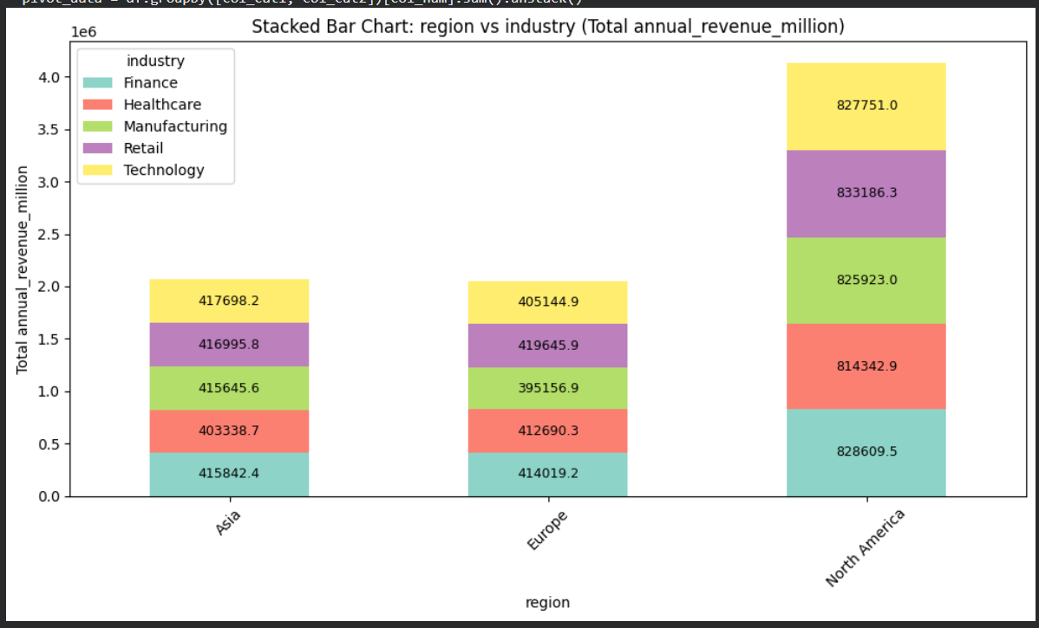
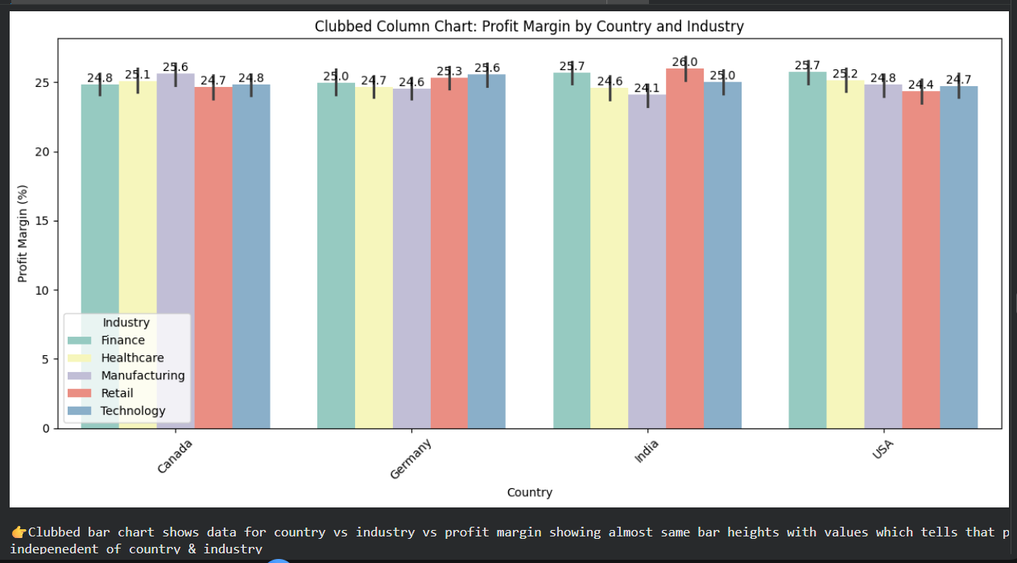
EDA · Industry Dataset
Stacked Bar Chart showing Industry vs Region vs Revenue showing different colors & sizes based on 3 cols combinations telling North America has more revenue compared to other regions
0.55
0.52
0.55
Clubbed Bar Chart showing Industry vs Country vs Profit Margin showing different colors & bar. It shows bar sizes are almost same in size for all telling the data is evenly distributed.
0.52
1.00
EDA on Industry Data · 11

Slide 13
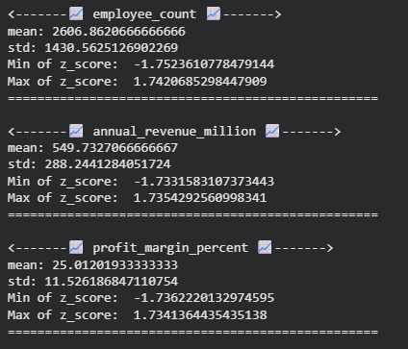
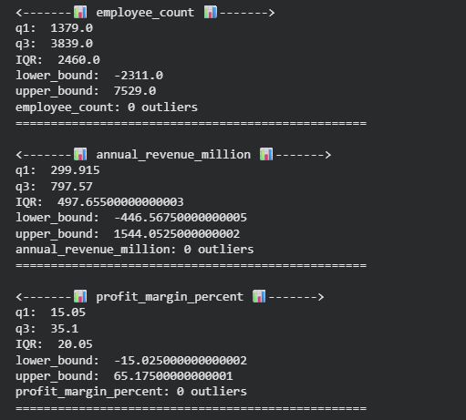
EDA · Industry Dataset
Outlier Detection
1. IQR Method
2. Z-Score
Detects outliers based on data spread using:
Lower bound = Q1 − 1.5 × IQR
Upper bound = Q3 + 1.5 × IQR
Measures how far a data point is from the mean (in standard deviations). Common threshold: |Z-score| > 3 → outlier
EDA on Industry Data · 13

Slide 14
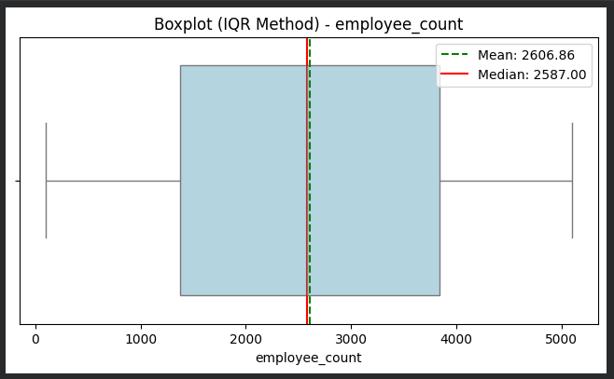
EDA · Industry Dataset
Outlier Detection
3. Boxplot Visualization
All the 3 outlier methods indicate that employee count, annual revenue, market rating, customer count and profit margin are all evenly distributed with no visible outliers:
1. Since rating scale is bounded likely 0–5, all values fall within range → no outliers detected.
2. The Z-score analysis confirms that all variables fall within ±2 standard deviations, indicating a well-balanced and normally distributed dataset with no outliers.
3. The close alignment of mean and median across\n all variables suggests low skewness and strong data symmetry, making the dataset statistically clean and suitable for further analysis.
Visual tool that highlights: Median, quartiles, and spread Outliers as individual points beyond whiskers
EDA on Industry Data · 13

Slide 15
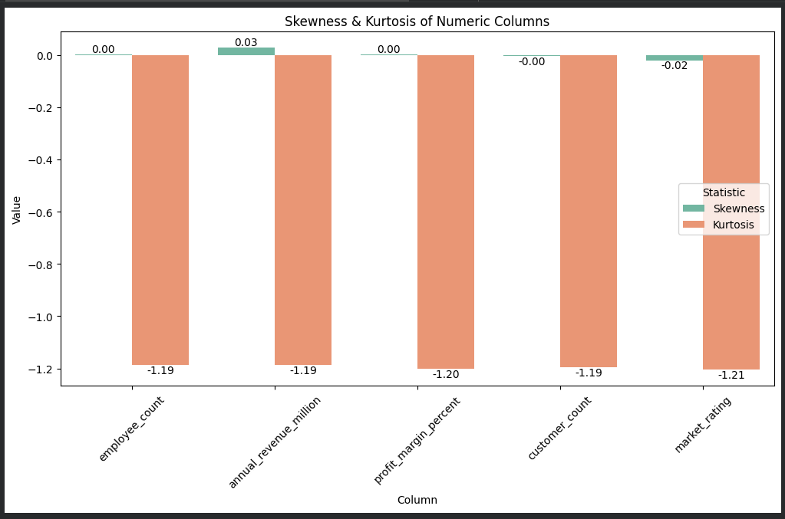
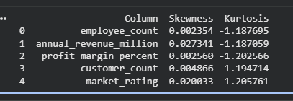
EDA · Industry Dataset
Skewness & Kurtosis
Skewness : Measures the asymmetry of a distribution around its mean. It tells you if your data leans left or right.
Types:
Positive skew → Long right tail; mean > median (e.g., income distribution).
Negative skew → Long left tail; mean < median (e.g., exam scores where most students score high).
Zero skew → Perfect symmetry (normal distribution)
Kurtosis tells you if your data is flat or sharply peaked with heavy tails. Together, they help you judge whether your dataset behaves like a normal distribution or needs adjustment before analysis.
Types:
Mesokurtic (≈3) → Normal‑like peak and tails.
Leptokurtic (>3) → Sharp peak, heavy tails → more outliers.
Platykurtic (<3) → Flat peak, light tails → fewer extremes.
4
EDA on Industry Data · 14

Slide 16
EDA · Industry Dataset
Key Insight Themes
1
Scale vs Profitability
Larger firms by employee_count generally lead revenue, but the highest profit_margin_percent values often emerge from mid-sized, focused players.
2
Geographic Concentration
A small set of countries drives the bulk of records; region rollups expose where industries cluster and where coverage thins.
3
Cohort Dynamics
Founding year cohorts show distinct industry mixes; recent vintages skew toward technology and platform business models.
4
Quality Signal
market_rating correlates more with profit_margin_percent than with raw size — quality of earnings matters more than scale.
EDA on Industry Data · 14

Slide 17
Thank You

